Slide 1
Enhancing Customer Satisfaction at Shopzilla Through Data Analysis
A Hands-On Data Analytics Project
Name: Shantal Rivas
Tools Used: BigQuery (SQL), Tableau

Slide 2

Why This Project?
📌 Content:
I wanted to work on a project that mimics real-world challenges in e-commerce.
Customer satisfaction is a key factor in retention, so I decided to analyze what drives complaints and how businesses can improve.
Main Goal: Identify the key drivers of low CSAT and suggest data-driven improvements.

Slide 3
The Business Problem (ASK Phase)
What’s happening? 📉 Shopzilla’s CSAT scores are dropping due to rising customer complaints.
Main Questions:
  What are the top reasons for customer complaints?
  How do agent performance & response time affect CSAT?
  What actions can be taken to improve satisfaction?
Key Stakeholders
Customer Support Managers | Operations Team | Executives & Strategy Team

Slide 4
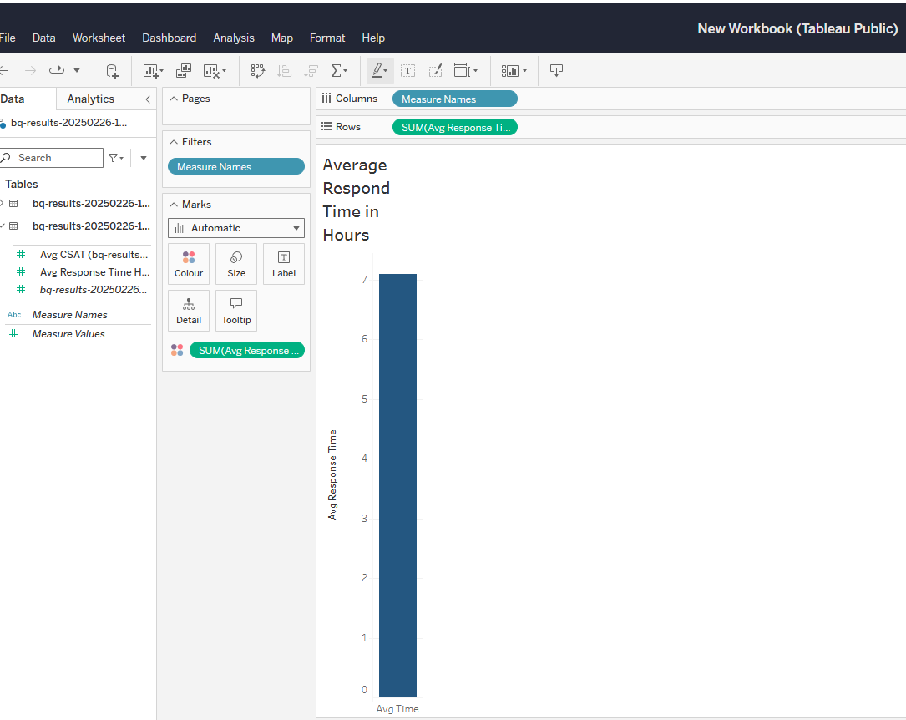
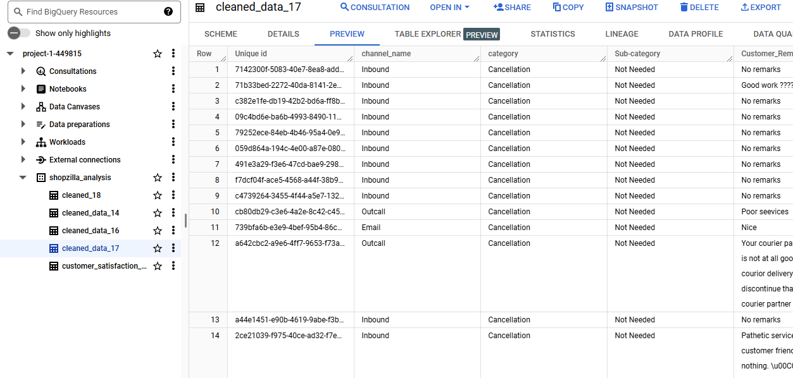
Data & Tools (PREPARE Phase)
Dataset: Kaggle (85,907 rows, 20 columns)
Tools I Used:
✅ BigQuery (SQL) – Data extraction & cleaning
✅ Tableau – Visualizing insights
✅ Google Data Analytics Process – Structured problem-solving

Slide 5
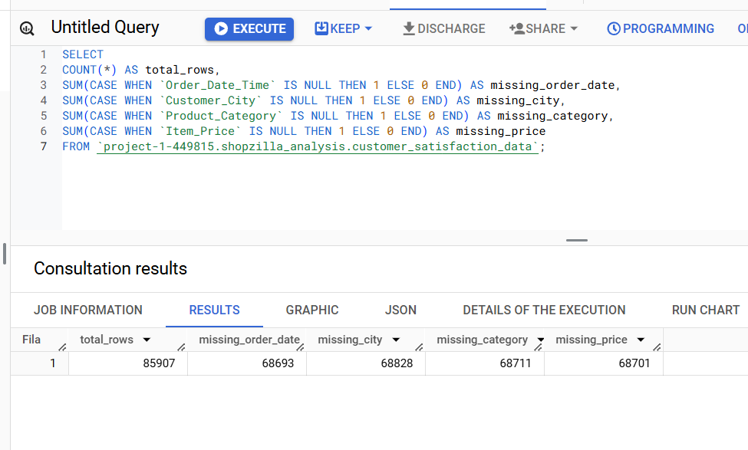
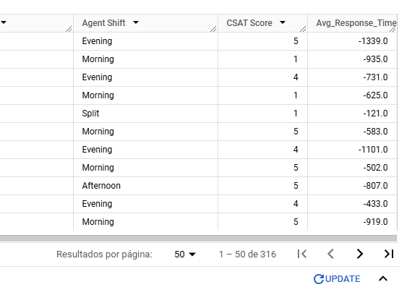
Data Cleaning & Preprocessing (PROCESS Phase)
Main Issues Found:
✅ Missing Values → Handled with replacements ("Unknown"/"Unspecified")
✅ No Duplicates found
✅ Time Format Issues → Converted response time from minutes to hours
✅ Incorrect Timestamps → Removed negative values

Slide 6
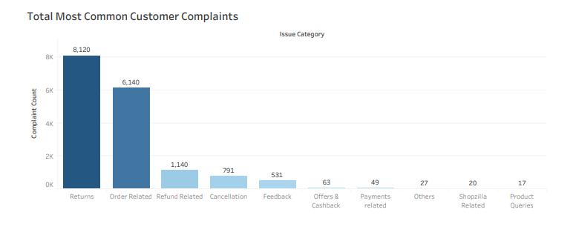
Key Findings – What Are Customers Complaining About?
Most Common Complaints:
  48.1% → Returns Issues
  36.4% → Order Issues
Key Insight: “Returns & order-related problems account for over 80% of all complaints. This suggests that product quality & logistics need improvement.”

Slide 7
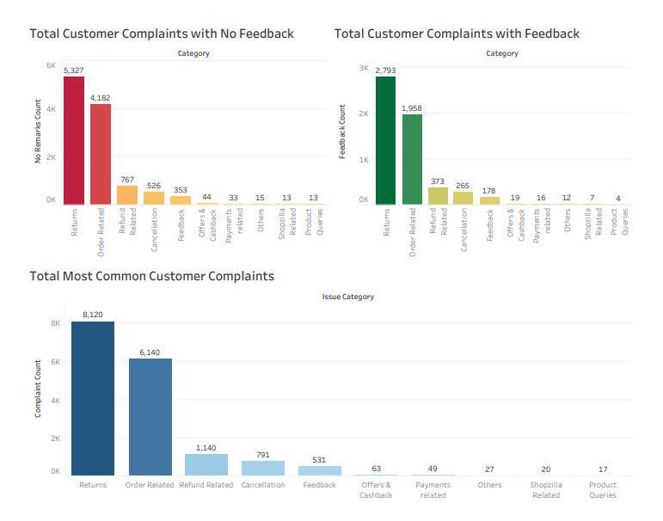
Why Are Customers Not Giving Enough Feedback?
Many complaints lack customer remarks:
  65% of return complaints = "No feedback provided"
  68% of order complaints = "No feedback provided"
What this means: “Customers might not feel encouraged to leave detailed feedback, making it harder to fix specific issues.”

Slide 8
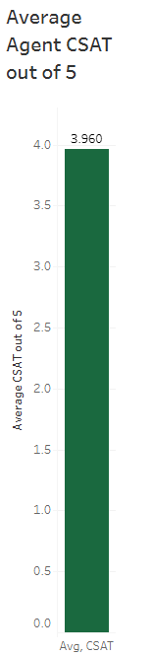
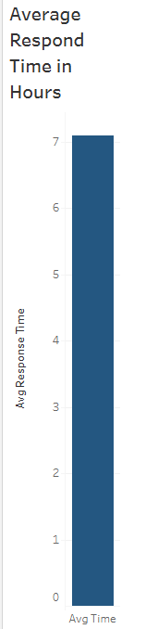
Key Findings – How Fast Do Agents Respond? (CSAT Impact)
Avg CSAT Score: ⭐ 3.96/5 (Decent, but room for improvement)
Avg Response Time: ⏳ 7.09 hours (Below industry benchmark)
Key Insight: Faster response times = higher CSAT.

Slide 9

Recommendations – Fixing Product & Logistics Issues
🔹 Better Quality Control → Pre-shipping inspections & packaging checks
🔹 Faster Shipping → Partner with reliable carriers, offer real-time tracking
🔹 Simplify Returns → Clear policies, prepaid return labels

Slide 10
Recommendations – Customer Support & Feedback
📌 Content:
🔹 Monitor Response Times → Reduce to <7 hours
🔹 Use AI for Faster Replies → Automate common inquiries
🔹 Encourage Customer Feedback → Incentives like discounts/loyalty points
🔹 Track Complaints Automatically → AI-based categorization

Slide 11
Final Takeaways & Business Impact
📌Key Takeaways:
Returns & order issues = main drivers of CSAT decline
Faster response times = happier customers
Small changes (better logistics & communication) can have a big impact
✅ Expected Impact:
CSAT increase: +0.5 to 1 point
More repeat customers, fewer complaints

Slide 12
Full detailed project here: https://drive.google.com/file/d/16QwWUj08SBrtAecK4ia5QcnDloMjsAck/view?usp=sharing

